Slide 1
AVID Tutorials Crash Course for Tutors
Gettin’ it done at Austin High

Slide 2
AVID Tutorials: Not your average show and go.
Watch this short video clip that goes with Jay Matthews’ book Question Everything: The Rise of AVID as America’s Largest College Readiness Program.
http://www.wiley.com/WileyCDA/Section/id-823521.html

Slide 3
What’s up with this?
So, what did you notice about the clip you just watched? In what ways was it similar to tutorials you have been to outside of AVID? In what ways was it different?

Slide 4
Why so different?
If you are told how to do something, you often don’t understand the underlying concept of WHY you are doing it, so if you see the same concept in a slightly different situation, you are lost once again.
By asking questions that lead the student to the answer, the student gets a much deeper and more applicable understanding of the content.
Inquiry is a key component of AVID.

Slide 5
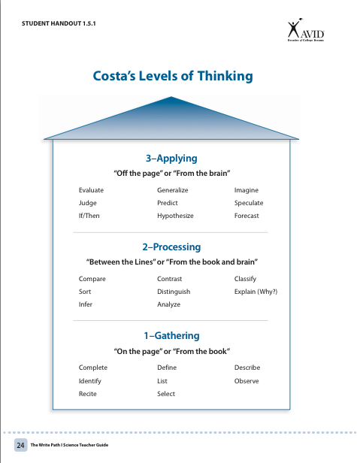
The deeper the inquiry the better.
In AVID, whenever possible, we try to push up from gathering/identifying/just the facts questions/ thinking to processing and all the way up to applying.

Slide 6
Are fact based questions bad?
Not necessarily. Sometimes you need to ask some to ascertain basic understanding of facts, formulas, definitions and the like. But we want to push up to the attic, so that by the end, the student is APPLYING what they have learned.
Students will have to demonstrate an understanding of the steps to take, so that they can apply their new understanding to future problems.

Slide 7
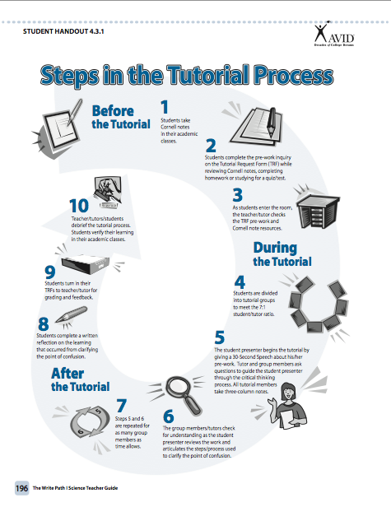
The full process
Steps 1-3 happen before students come to class.
Steps 4-7 are the during the actual tutorial.
Steps 8-10 happen once the tutorial has finished.
Let’s take a minute and look at each one.

Slide 8
Now let’s watch a longer tutorial session video.
As you watch, feel free to take notes, jot down observations and questions.
https://www.youtube.com/watch?v=8wDTMBeigRw

Slide 9
So what is it that kids are doing BEFORE class?
They do the front side of their TRF (Tutorial Request Form). The front side is the pre-work.
https://www.youtube.com/watch?v=sxm13Dgskm4

Slide 10
As a tutor, what will my work look like?
Obviously, you will be facilitating the tutorial process during steps 4-7, but beyond that there might be a bit more going on.
In Ms. Masters’ AVID classes, which are 11th grade classes and meet 1st and 2nd period, you will sort TRFs, and grade pre-work before steps 4-7.
Afterward, you will grade all elements except the reflections. The teacher will grade those and give students the final grade.

Slide 11
Why?
Because I can not be in all tutorial groups at once, I cannot know if every student participated in inquiry (helped by asking questions and leading their group members towards understanding). I may miss if someone had their resources (notes, book, class examples) or not. I won’t know if every student took three column notes for every presenter or not. You will know. If you aren’t sure, ask to see the notes and check them over.

Slide 12
Here’s how it goes
Remember, other AVID teachers might do it a bit differently. Flexibility is key.
TRFs are due at the start of class. The tutors take them, grade the pre-work (so students can’t fake us out by finishing during the tutorial) and decide how you will split them up – who will be in each tutorial group. If we don’t have enough tutors, don’t worry. One of my kids will take the role of tutor in any “loose group”.
Group the students by subject/level. If there are a few that don’t fit, try to match by level. If there is only one physics question, but it is pre-AP, put them with pre-AP algebra II, for example. More than likely another kids in the group will have a clue.

Slide 13
What is going on while you do this?
Again, this will depend on the AVID level. Ms. Masters juniors are now pros at trade-and-grade binder and Cornell Note checks, so we will knock these out while you do your part.
Other grades may do quick check-ins, announcements, or review a quick skill.
Freshmen and sophomore teachers might send non-TRF finishers to the hall to finish their work and deduct points for lateness at the beginning until everyone is on board (in Ms. Masters’ room kids just lose the pre-work points, but still need to present something and participate in the full tutorial).

Slide 14
Check to see if the teacher has any rule “exceptions”
For example, in Ms. Masters room, if the academic vocabulary on their pre-work that they need for the problem is something they have surely known for years—equation, for example, they don’t have to define it. But use your judgment or ask them about it if you think there should be other, more complex vocabulary they need. Use your judgment, too, if it looks like an obviously new word that they would have covered recently in class, but they have not defined it.

Slide 15
Make sure you choose urgent POCs first.
For example, if someone has a major test tomorrow that will include the POC (Point of Confusion) or if not understanding this point is keeping them from grasping a whole unit, have those students present first…just in case we don’t get through everyone.
You will take the seat of the presenter and you will take notes for that student as the tutorial unfolds, so that they will have the notes to look back on if they need them.
Each time a new student presents, you will take their seat and take their notes for them.

Slide 16
What if we are really stuck?
In Ms. Masters’ room, we have Chromebooks. Other teachers may have other devices available. The rule during tutorials in Ms. Masters’ room, is that the tutor (or student taking that role) can authorize the use of a Chromebook. Just grab one. The group can look up examples or references online. We know fewer and fewer teachers use textbooks.
NO PHONES DURING TUTORIALS.
If a group finishes early, they may get permission to use Chromebooks or phones from me.

Slide 17
After the tutorials…
I will stop tutorials with a few minutes left. The students will write their reflections and hand their TRFs back to you.
If you need to look at anyone’s three column notes, do so while they are writing the reflections.
Quickly grade resources, inquiry and notes.
Hand me your stack of TRFs.

Slide 18
Questions?
If you think of any later, email Ms. Masters at:
maura.masters@austinisd.org.
Know that this will make far more sense and will get easier and easier as you participate.
Either you will be working with older students who are used to the process or younger ones who will be training, too, so you will have plenty of support.
And all the AVID teachers are very grateful for your help, so we will support you!

Slide 19
AVID Teachers/Periods
9th grade: Ms. Zarate (P5A), periods: 7,8
10th grade: Ms. Nunez (313), periods: 3,4
11th grade: Ms. Masters (315), periods: 1,2
12th grade: Mr. Matheny (P1A), periods: 5,6

